Slide 1
Network extension
Dr. Friederike Ehrhart
Department of Bioinformatics – BiGCaT
Maastricht University

Slide 2
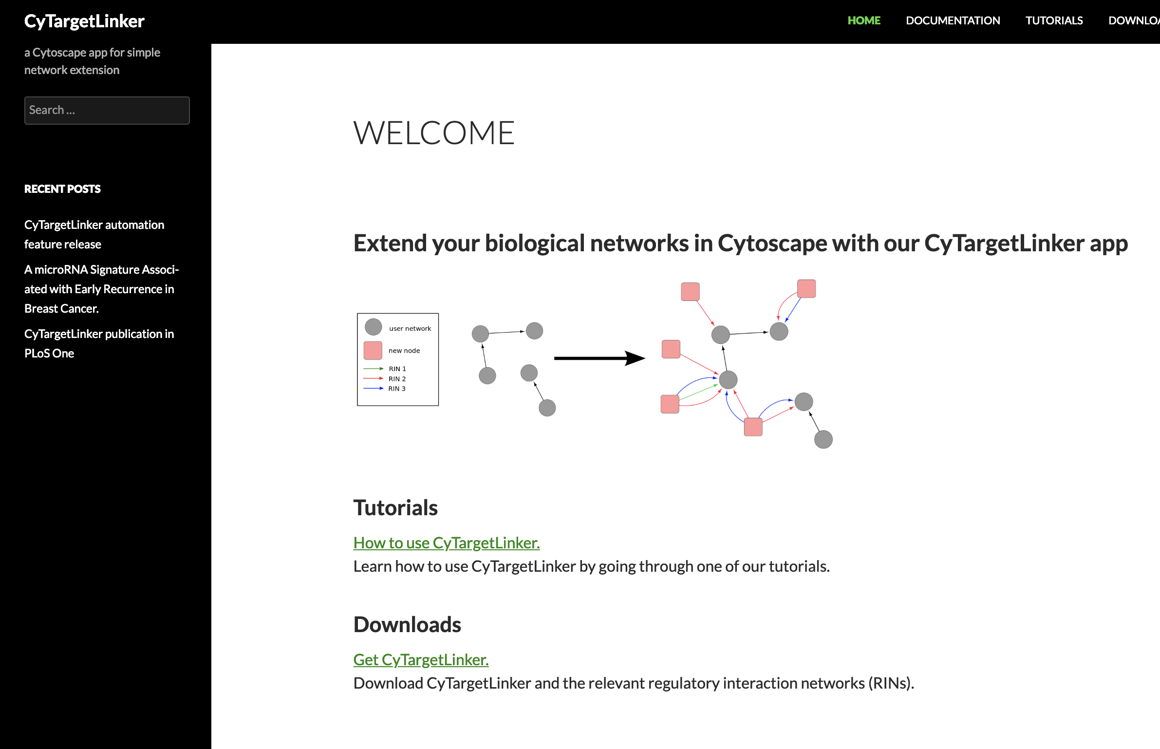
Network extension

Slide 3
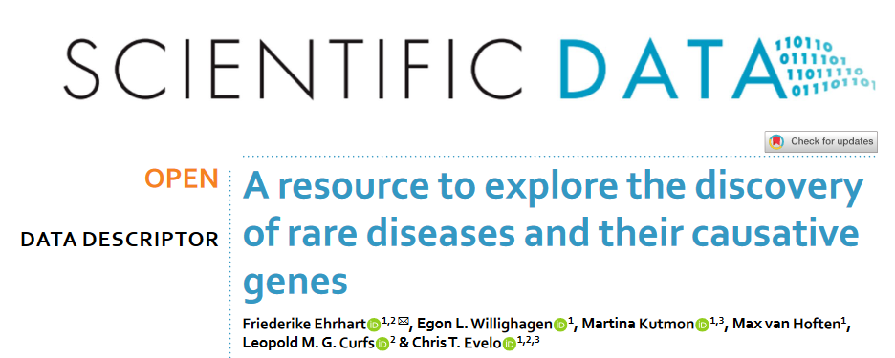
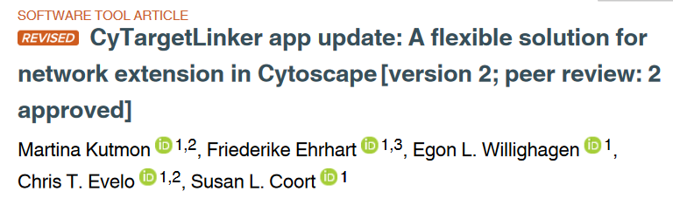
CyTargetLinker app for Cytoscape
Currently available:
Drugs (DrugBank)
Transcription factors (ENCODE)
miRNA (MirTarBase)
Chemical compounds (ChEMBL)
Pathways (WikiPathways/Reactome)
Rare diseases (OMIM, Orphanet)

